Slide 1

Energy Consumption Analysis
M.Pavan Datta
Peddi Vamshi Krishna
Guguloth Santhosh
Batch 403
Innomatics Research Labs ,
Dilsukhnagar

Slide 2

Objective of the Project
The objective of studying and understanding worldwide energy consumption is to track, analyze, and manage how energy is produced, distributed, and used across the globe.
To balance energy demand and supply while ensuring efficiency, sustainability, security, and affordability for global development.

Slide 3
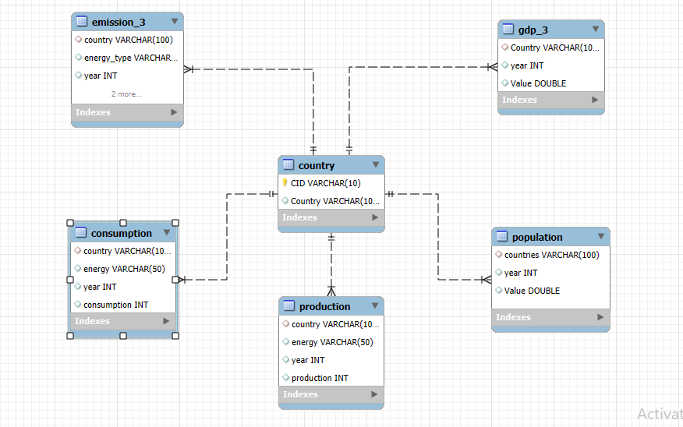
ER Diagram

Slide 4
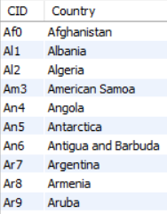
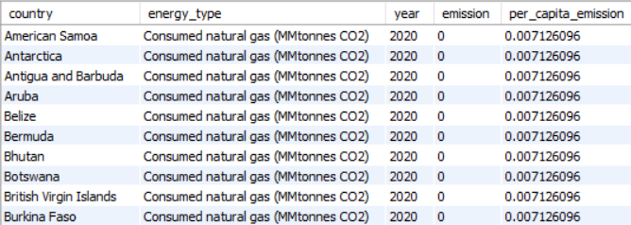
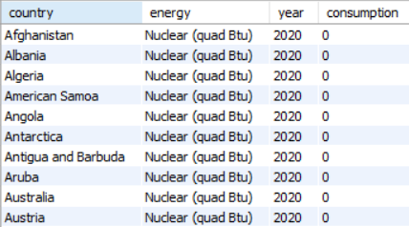
About Tables
Country Table
Emission_3 Table
Consumption Table

Slide 5
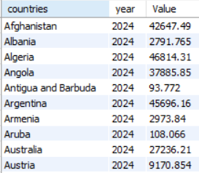
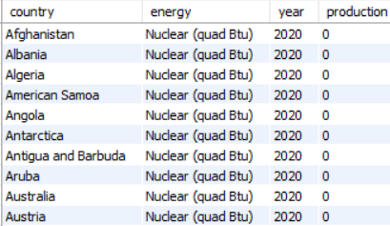
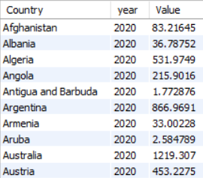
Population Table
Production Table
gdp_3 Table

Slide 6
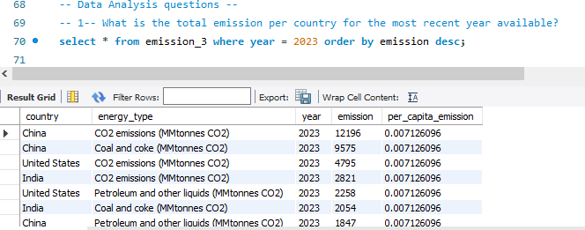
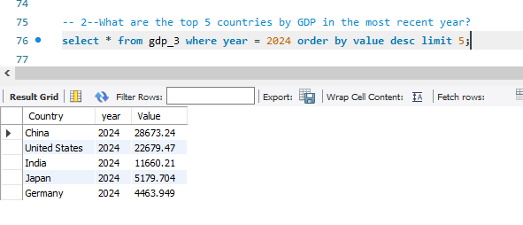
Data Analytics Questions ,Queries and Output
1. Total emission per country recent year ?
2. Total 5 countries by GDP ?

Slide 7
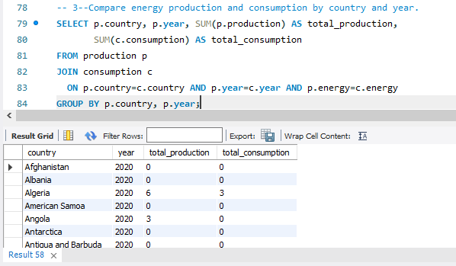
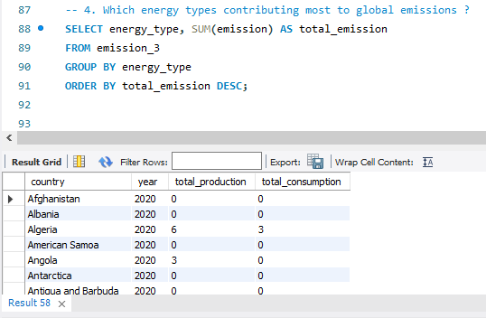
3. Compare energy production and consumption by country and year
4. Which Energy types contributing most to emissions

Slide 8
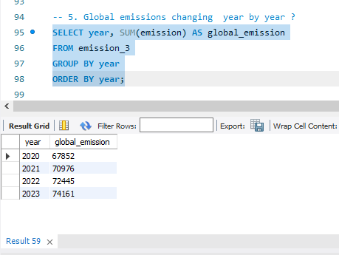
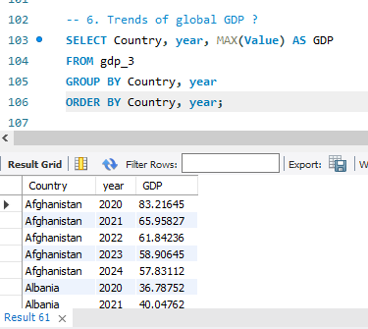
5. Global emissions changing year by year ?
6. Trends of global GDP ?

Slide 9
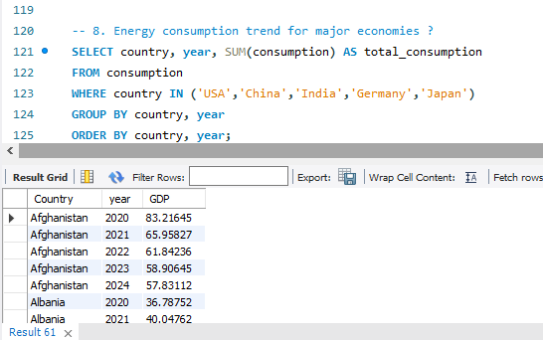
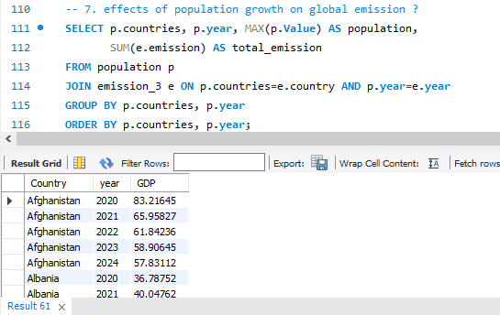
7. Effects of population growth on global emission ?
8. Energy consumption trend for major economies ?

Slide 10
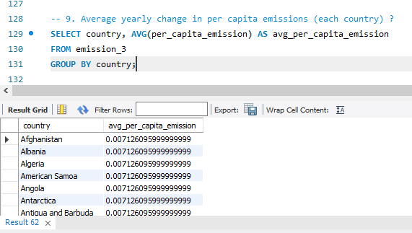
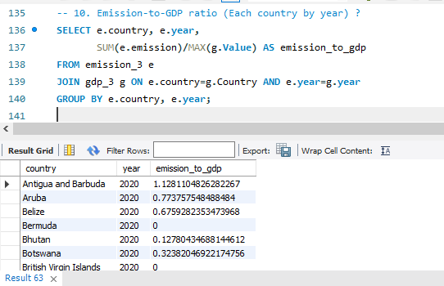
9. Average yearly change in per capita emissions (each country)
10. Emission-to-GDP ratio (per country per year)

Slide 11
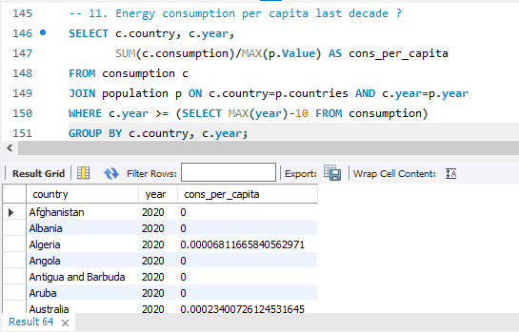
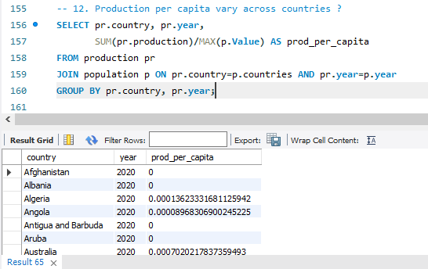
11. Energy consumption per capita last decade ?
12. Production per capita across countries

Slide 12
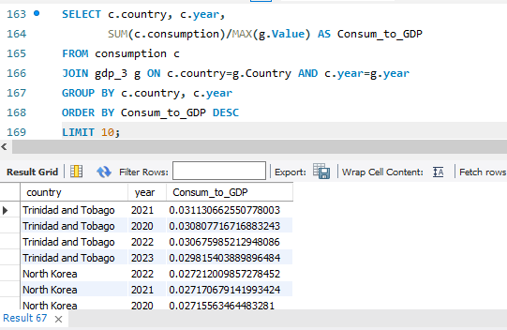
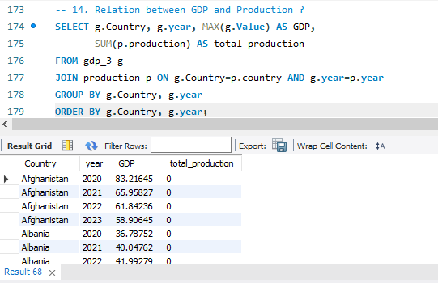
13. Highest energy consumption relative to GDP
14. Relation between GDP and Production

Slide 13
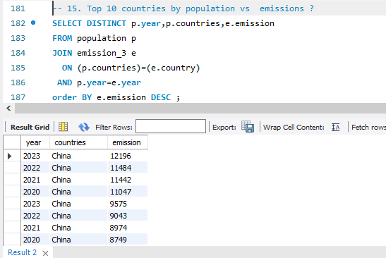
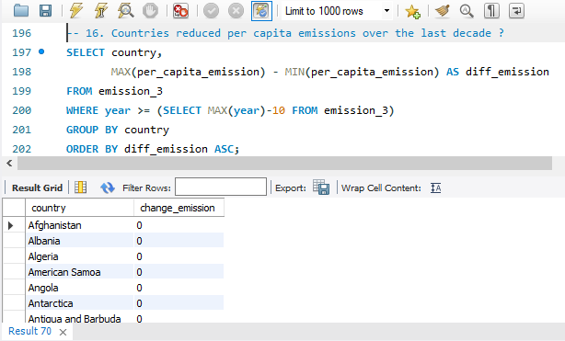
15. Top 10 countries by population & their emissions
16. Countries reduced per capita emissions over last decade

Slide 14
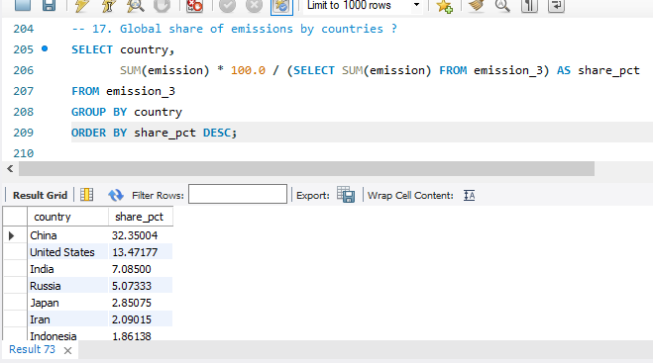
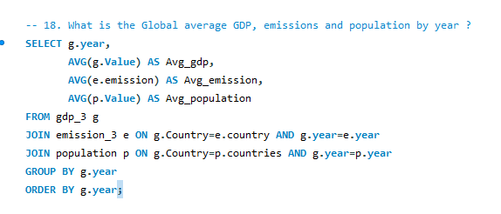
17. Global share of emissions by countries
18. Global average GDP ,emission & population by year

Slide 15
Insights and Recommendations of analysis :
Few developed countries are responsible for most global emissions.
When GDP increases, emissions are bound to increase naturally.
Population Explosion resulted in higher energy consumption and as a result emissions have also increased .
Dependency on fossil fuels is still higher than the Renewable energy usage. There is need of big shift from non-renewable to renewable energy.
Ideal countries are successful in increasing their productivity and GDP while keeping emissions in check . Some countries are successful in this aspect.

Slide 16
Conclusion :
Therefore, the analysis highlights that Economic Development, Population growth, and Modern advancements in production and consumption consumes more energy which inturn results in Elevated emission levels. However, some countries stand as an example to the world that growth with sustainability is not a moon rock and it can be achieved with green energy and better practices.

Slide 17
Experience/Challenges Working on SQL – Data Analysis Project
It was challenging while importing data from Data Import Wizard
Understanding data is required before using joins and groupby and perform analysis.
Mysql work environment was user friendly and beginner friendly.
Few observations in datasets were missing ,and handling them was a challenge.
Improved our analysis skills and query handling techniques.

Slide 18
Thank You

